Slide 1
Diabetes Prediction Model
By: Prathmesh Salunkhe

Slide 2
Index
Introduction
Motivation
Problem statement and objective
Existing method
Proposed method
Model architecture
Methodology
Implementation
Results
Conclusion

Slide 3
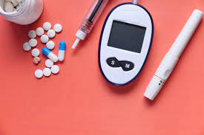
Introduction
India is the second most affected country by diabetes in the world.
Detection at early stage can be helpful for a person to reverse diabetes or reduce the impact on the life of patient.
A diabetic person has various restrictions on his life style. It is one of the world's fastest growing public health issues as well as one of the leading causes of death.
About 463 million people are living with diabetes worldwide.
The prevalence of diabetes among people aged 20–79 years is estimated to be 88 million with that number expected to rise to 115 million by 2030 and 153 million by 2045 in India .
These startling statistics point towards the emergence of a diabetes epidemic.

Slide 4
Motivation
It is difficult to identify diabetes in early stages. If identified, it can be very helpful for the patient.
The signs and symptoms are easily neglected by people. Also people don’t tend to go for testing for diseases out of fear.
Few sections of our society can’t even afford to consult a doctor for such diseases.
With the growth of artificial intelligence technology, disease prediction has been more accurate.
Various systems are built to predict diseases using data science and machine learning models. Same can be done to predict diabetes efficiently.
This model will be easily accessible to all and also be cost efficient. More and more people can check the possibility of diabetes in there body, helping them to fight with it early.

Slide 5
Problem Statement and Objective
Problem statement:
Prepare dataset and build a diabetes disease prediction model using Data Science.
Objective:
1. Prepare dataset using several methods
2. Build a model for disease prediction
3. Training and testing model

Slide 6
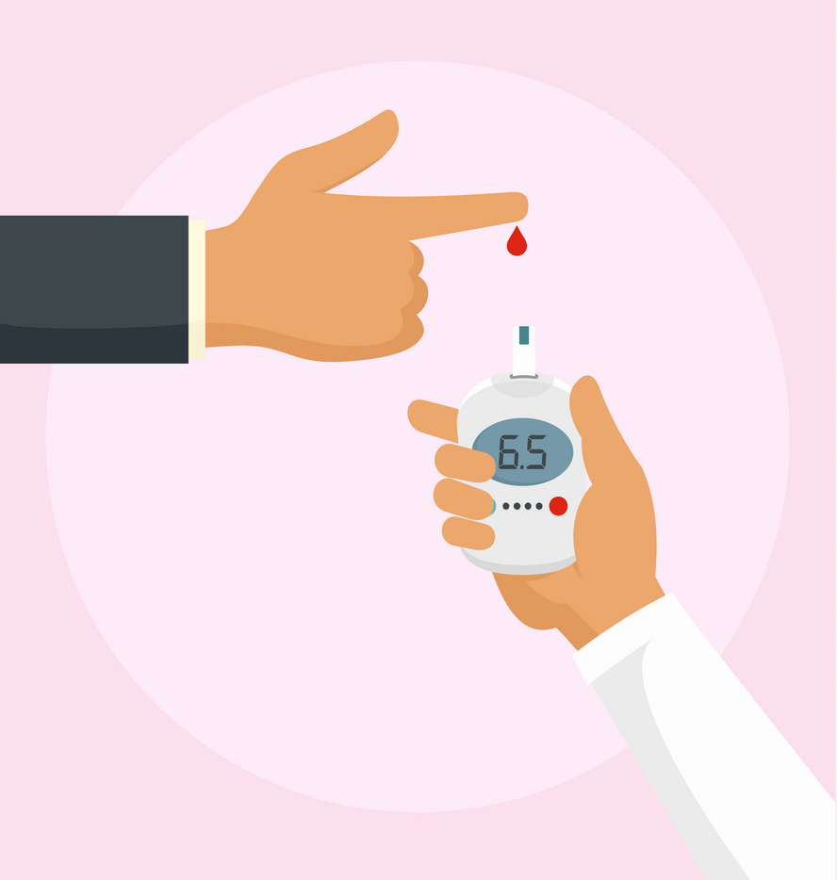
Existing method
Diabetes is predicted using the glucose level in the blood.
The main method is fasting plasma glucose test.
In fasting plasma glucose test, the blood sugar level is testing after overnight fasting.
Another test used to detect diabetes is A1C test. In A1C test the blood sugar level over past 2 – 3 months is measured.
The third test is Glucose tolerance test in which the blood sugar level is tested before and after drinking a liquid containing Glucose.

Slide 7
Proposed Method
Deep learning has shown immense growth in past decade. We have used deep learning models for the prediction purpose.
Using these models we can predict the possibility of diabetes in a person.
The model requires some input fields related to the persons such as weight, age, blood pressure etc.
Using these input fields the model will give an output which is a probability of diabetes in a patient.
We used Pima Indians diabetes database for training out model.
Model consists of input layer with 8 input nodes and an output layer with one output node. In between these two layers there are hidden layers.
After training model, we use this model for prediction of diabetes in a person by giving required fields to the model.

Slide 8
Model Architecture
For model building we have used torch.nn package
The model 1 consist of 4 layers. 1st and 2nd layer has 8 neurons, 3rd layer has 4 neurons and 4th layer is output layer with 1 neuron.
Model 2 consist of 3 layers. 1st layer has 8 neurons, 2nd layer has 4 neurons and 3rd layer is output layer with 1 neuron.
Model 3 consist of 4 layers. 1st layer has 8 neurons, 2nd layer has 4 neurons. 3rd layer has 2 neurons and 4th layer is output layer with 1 neuron.
These different model provide different accuracies.

Slide 9
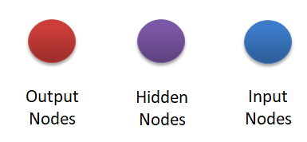
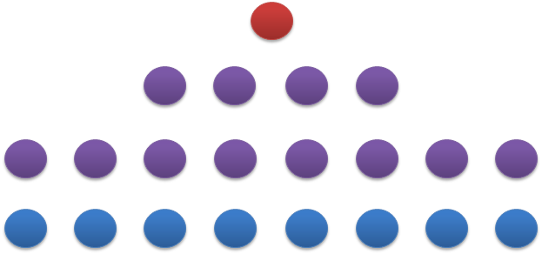
Model Architecture
Architecture of model 1

Slide 10
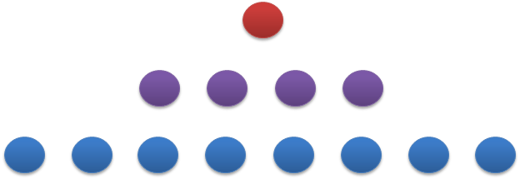
Model Architecture
Architecture of model 2

Slide 11
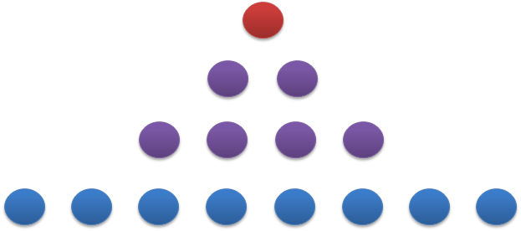
Model Architecture
Architecture of model 3

Slide 12
Methodology
The complete system is divided into different smaller tasks.
The dataset we used is from Pima Indians diabetes dataset.
Dataset visualization is performed using available libraries.
The dataset is split into three parts i.e. train, test and validation for different purposes.
The model is built using deep learning principles. The models are then trained on the train dataset.
We are using GPU for faster fitting of model as it provides high computational power as compared to CPU.
Hyper parameter tuning is done using the test accuracy results on the model.
Then this model can be hosted and used for predicting the diabetes in a patient.

Slide 13
Implementation
We used Google Colab for implementation as it provides GPU service. We used python programming. PyTorch framework is used for model building and Pandas library is used for dataset cleaning.
SOFTWARE REQUIREMENTS:
· Programming language: Python 3
· Platform: Google Colab
· Framework: PyTorch 1.9.0v
· Plotting: Mathplotlib 3.2.2v, Seaborn 0.11.1v
· Dataset analysis/cleaning: Pandas 1.1.5v, Sklearn 0.22.2v, Numpy 1.19.5v

Slide 14
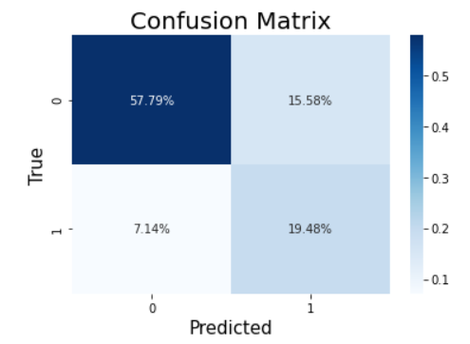
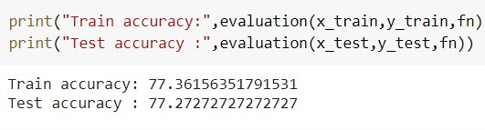
Results
Implementation of model using PyTorch we got a maximum train accuracy of accuracy of 77.36% and test accuracy of 77.27%.

Slide 15
Conclusion
In this project we have used data science and deep learning algorithms to predict possibility of diabetes in a person.
Early detection of diabetes is helpful for reduction of effect of the diabetes disease on a person’s life.
Conventional methods for diabetes detection are accurate but people ignore the signs and symptoms of disease.
We have built a model which can be used by providing minimum input fields related to patient.
This model can help people to detect diabetes in its early stages.

